Slide 1

Using a Web Server
The SoftServe Server
Moving Files to the Server
Bookmarks
Targeting a new Window

Slide 2

See Also
https://www.youtube.com/watch?v=bCt2FnyY7AE
http://www.webhostingbest10.com/

Slide 3

In the Book
Chapter 4:
Getting Connected

Slide 4
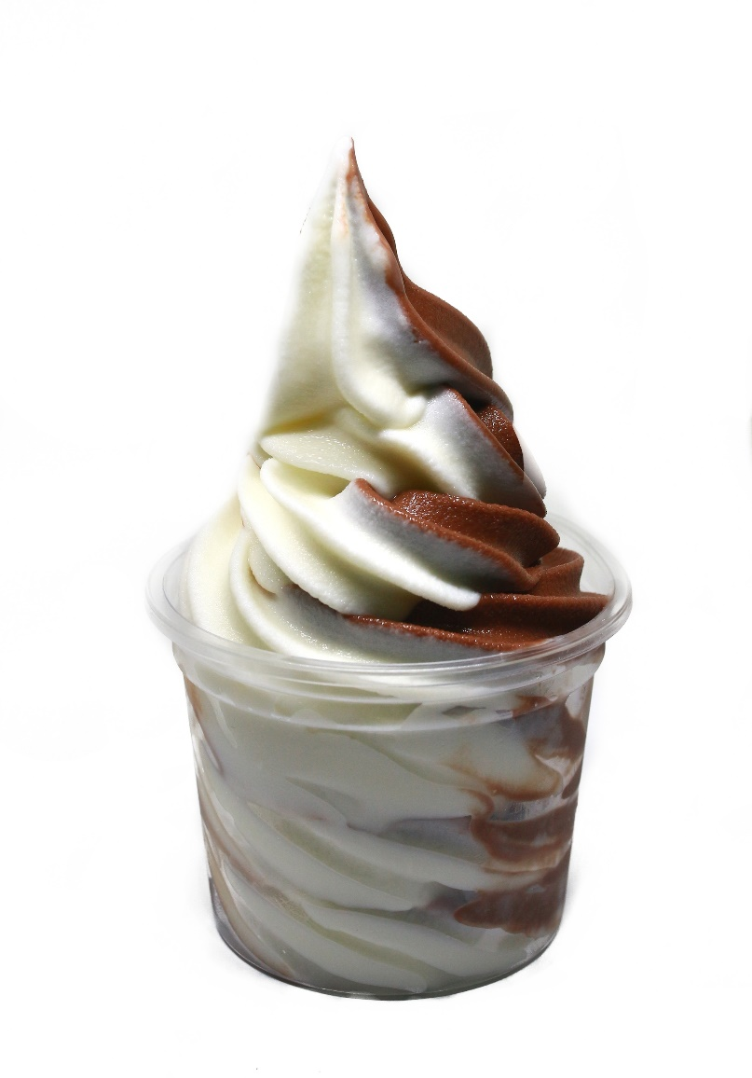
SoftServe
SoftServe is an extremely small Java web server I wrote for these classes.
Easy to test your web site locally
https://github.com/topherCantrell/SoftServe
Download the class file
Make a batch file to start it with your desired settings
Place the CLASS and BAT file on your desktop.
Double click the BAT to start the server.

Slide 5
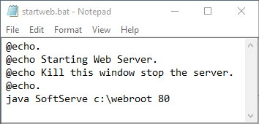
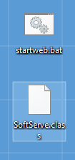
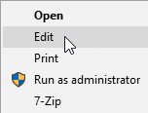
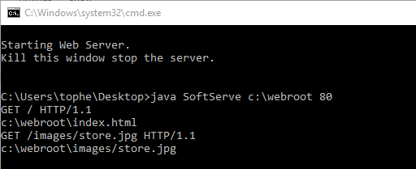
Using SoftServe

Slide 6
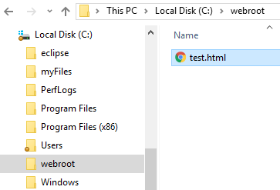
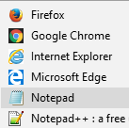
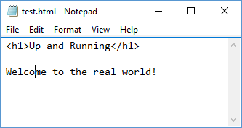
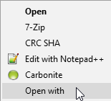
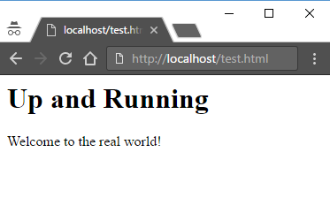

Using SoftServe

Slide 7
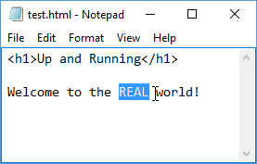
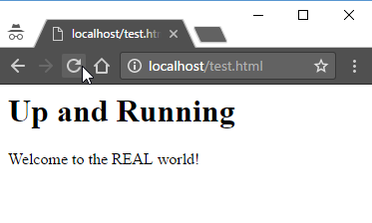
Using SoftServe

Slide 8
File Transfer Protocol (FTP)
ping -n 1 computerarcheology.com
C:\webroot>
Pinging computerarcheology.com [69.163.164.140] with 32 bytes of data:
Reply from 69.163.164.140: bytes=32 time=81ms TTL=46
Ping statistics for 69.163.164.140:
Packets: Sent = 1, Received = 1, Lost = 0 (0% loss),
Approximate round trip times in milli-seconds:
Minimum = 81ms, Maximum = 81ms, Average = 81ms
C:\webroot>

Slide 9

File Transfer Protocol (FTP)
ftp computerarcheology.com
C:\webroot>
Connected to computerarcheology.com.
220 DreamHost FTP Server
200 UTF8 set to on
User (computerarcheology.com:(none)):
331 Password required for topherCantrell
Password:
230 User topherCantrell logged in
ftp>
250 CWD command successful
ftp>
topherCantrell
***
cd computerarcheology.com

Slide 10
File Transfer Protocol (FTP)
ftp>
200 PORT command successful
150 Opening ASCII mode data connection for file list
Amiga
Arcade
Atari2600
favicon.gif
index.html
226 Transfer complete
ftp: 248 bytes received in 0.00Seconds 62.00Kbytes/sec.
ftp>
ls

Slide 11
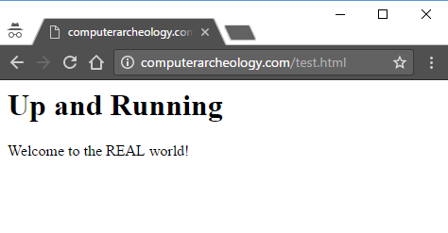
File Transfer Protocol (FTP)
put test.html
ftp>
200 PORT command successful
150 Opening ASCII mode data connection for test.html
226 Transfer complete
ftp: 53 bytes sent in 0.09Seconds 0.62Kbytes/sec.
ftp>
221 Goodbye.
C:\webroot>
quit

Slide 12
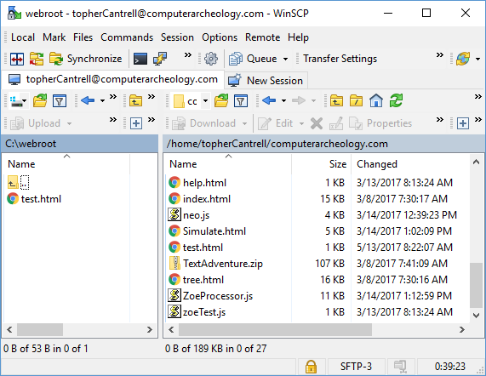

WinSCP
https://winscp.net/

Slide 13
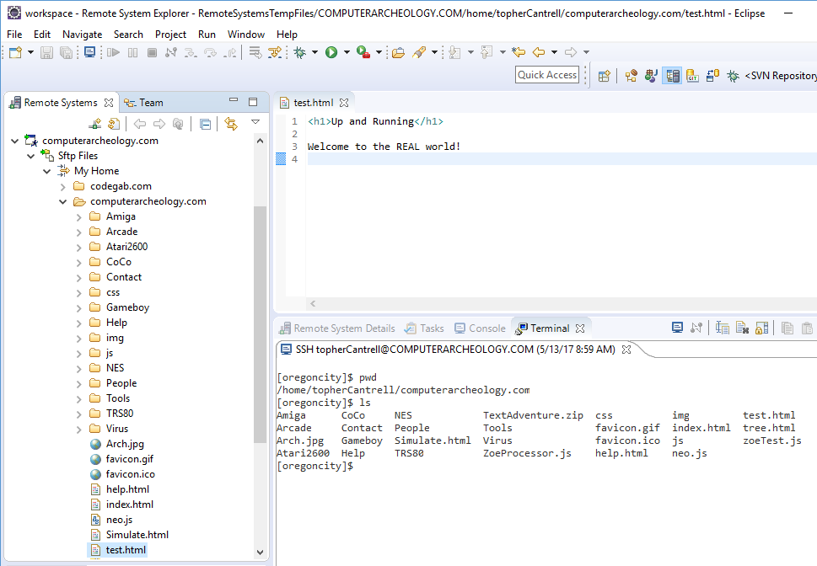
IDE (Eclipse)

Slide 14
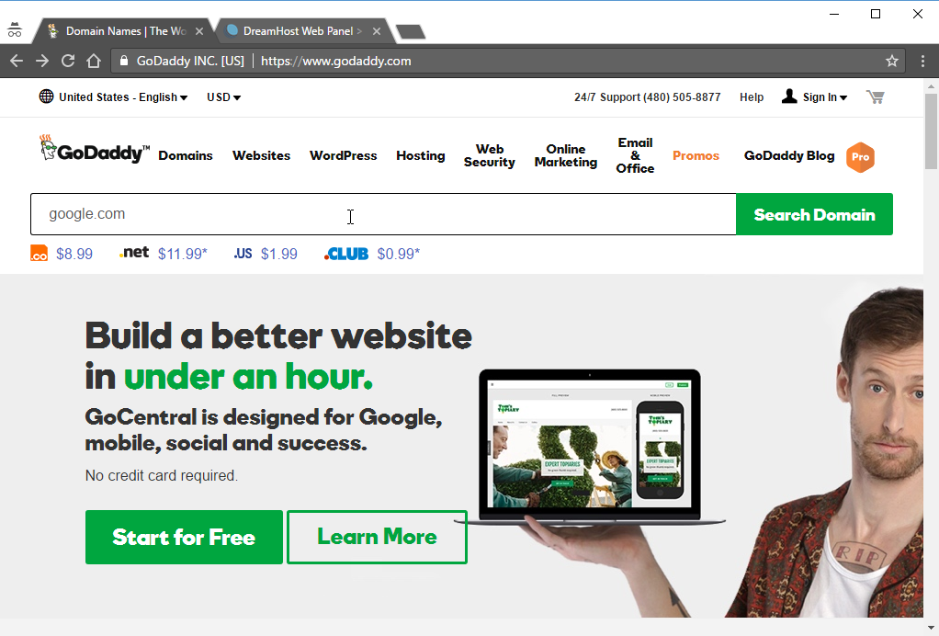
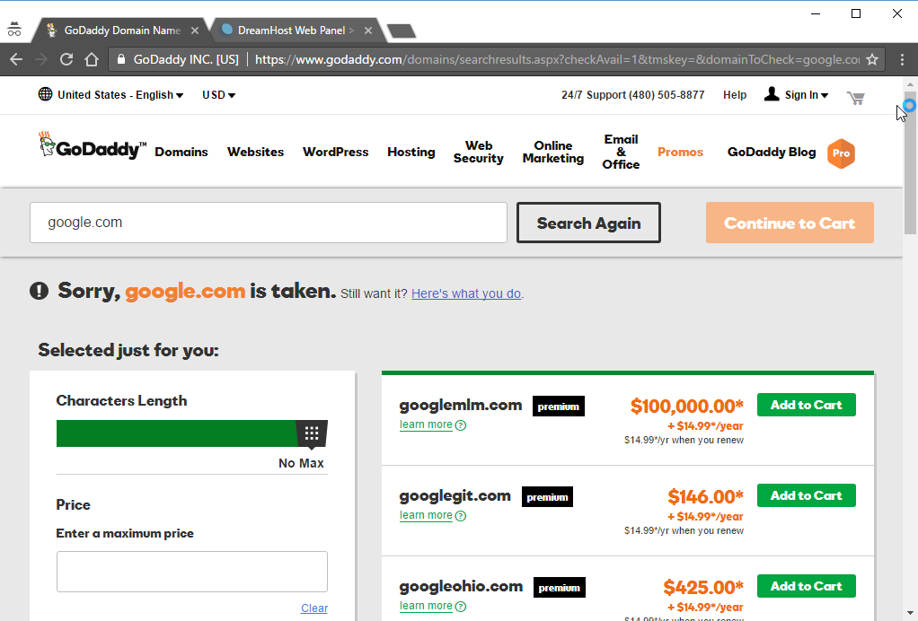
Domains

Slide 15
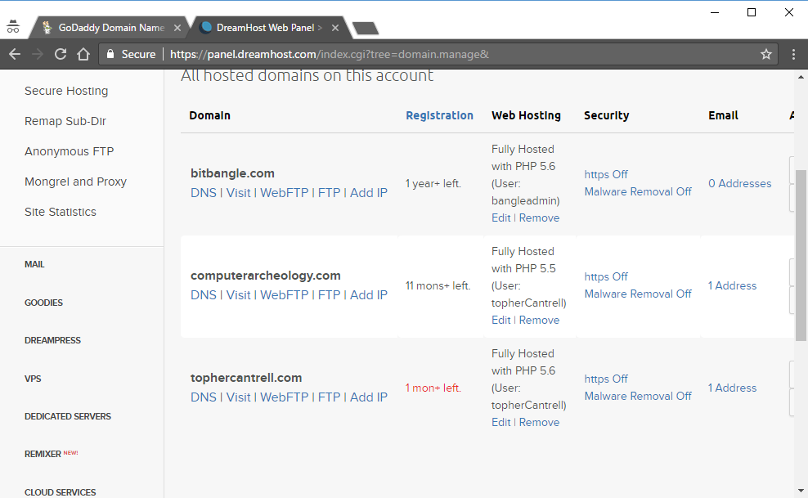
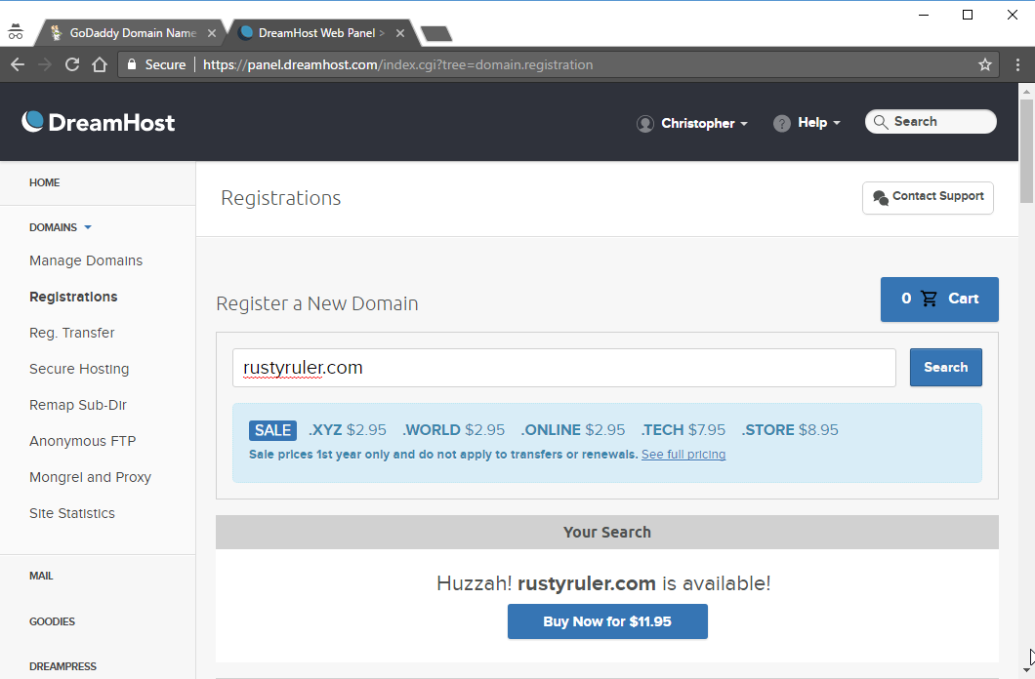

Domains

Slide 16

Title Attribute
<a href="google.com" title="Click here to visit Google">Google</a>
Click here to visit Google

Slide 17
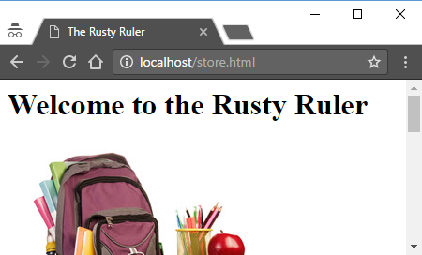
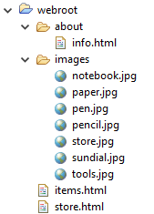
Default Pages

Slide 18

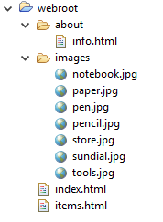
Default Pages

Slide 19
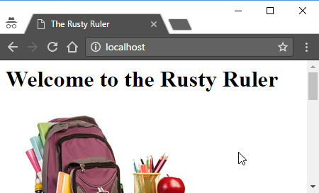
Default Pages
Configure web server to look for “index.html”
Configure what to do if default page is not found

Slide 20
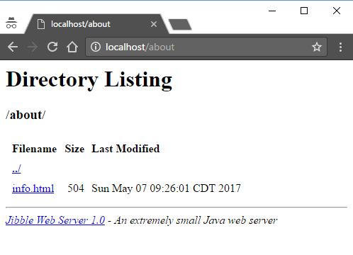
Default Pages
Probably want to turn this off in production
Server would return a 404 (Not Found)

Slide 21
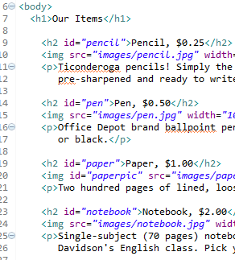
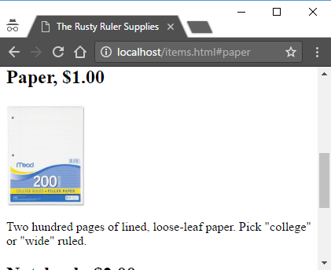
Bookmarks
<h2 id="pencil">Pencil, $0.25</h2>
<a href="items.html#paper">Our Paper</a>

Slide 22

Bookmarks
An id attribute can be given to any element.
The id should be unique on a page.
Used heavily in JavaScript to find a particular element.

Slide 23
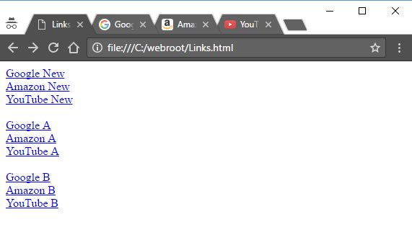
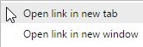
Linking to a new Window
<a href="http://google.com" target="_blank">Google New</a><br>
<a href="http://amazon.com" target="_blank">Amazon New</a><br>
<a href="http://youtube.com" target="_blank">YouTube New</a><br>
<br>
<a href="" target="windA">Google A</a><br>
<a href="" target="windA">Amazon A</a><br>
<a href="" target="windA">YouTube A</a><br>
<br>
<a href="" target="windB">Google B</a><br>
<a href="" target="windB">Amazon B</a><br>
<a href="" target="windB">YouTube B</a><br>

Slide 24
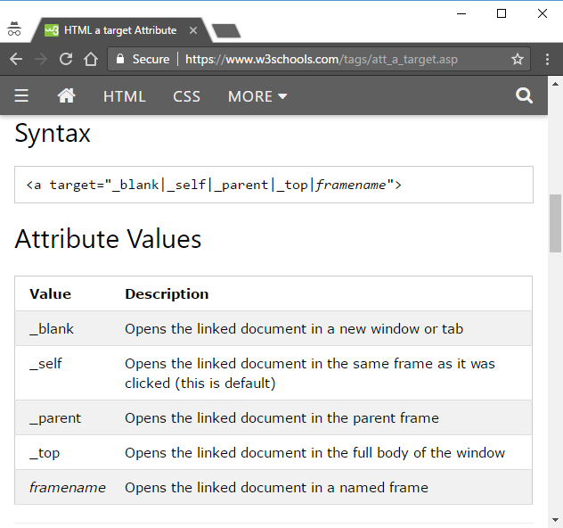

Target Attribute

Slide 25


Tinkering
Run SoftServe on your local PC. Create a “c:\combo” webroot directory and point the SoftServe starter batch file to it.
Add the “Rusty Ruler” and “Exercise 1” to the web root at the following URLs:
http://localhost/ruler
http://localhost/fungi
Tweak the HTML files as needed.

